Slide 1
Peer Observations
STATS/DATA 375
September 2021
Elisa Stone

Slide 2
Agenda
Rationale for observing teaching
Observation Cycle
Giving Critical and Useful Feedback

Slide 3

Why observe another instructor teaching?
→ Share your thoughts with someone next to you

Slide 4
Why observe another instructor teaching?
Increase “noticing” teaching moves
Observer learns new strategies
Instructor gets feedback and new ideas
Opportunity to collaborate

Slide 5
Observation Cycle

Slide 6

The Observation Cycle:
More than a checklist

Slide 7
Steps to take for a productive Observation Cycle:
Instructor shares lesson plan and focus question
Observer takes objective notes,
and later writes up questions/suggestions
Partners meet and discuss
Instructor reflects in writing

Slide 8
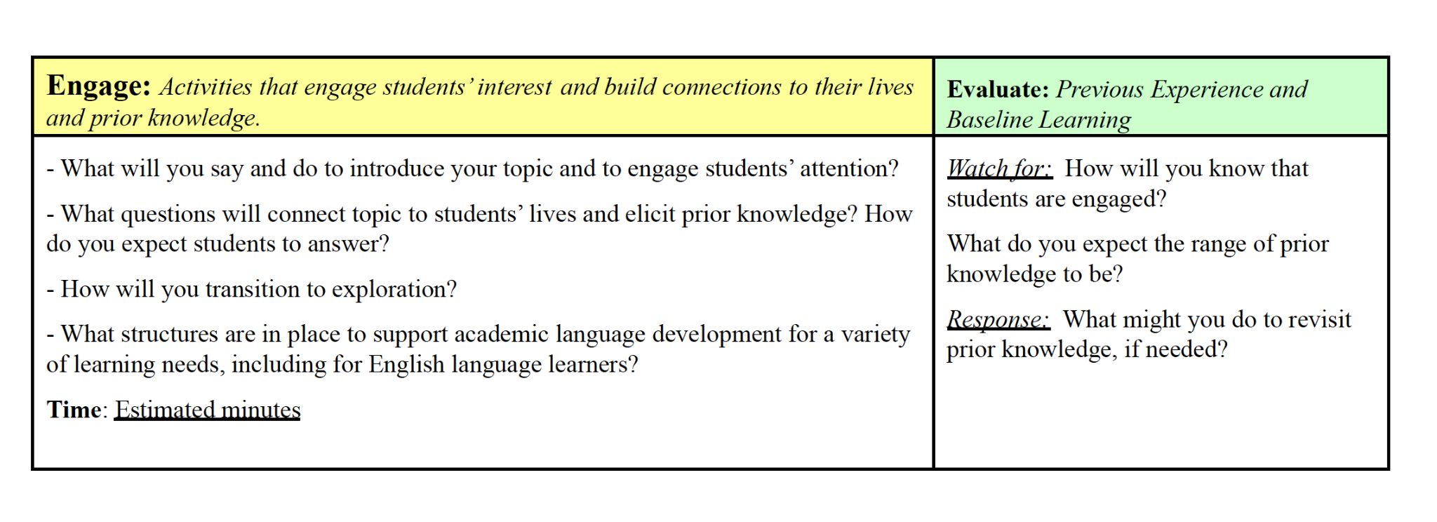
Step 1:
Share plan & focus questions
Example focus Qs: How am I engaging students’ attention? How am I evaluating/assessing prior knowledge?

Slide 9


Other example focus questions:
Are all students participating?
Which students respond to my questions?
→ Share your ideas with a classmate

Slide 10
Step 2a:
Observer takes objective notes
→ Share your observations notes from
this class with a classmate
What counts as an objective description?
What are instructor and students doing during class session?
time at which different activities occurred

Slide 11
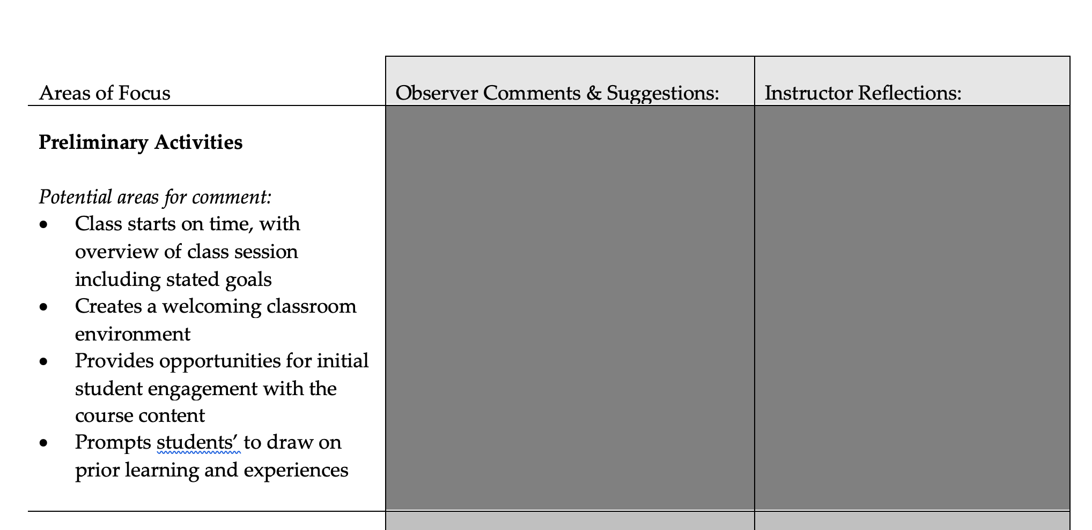
Step 2b: Observer comments/questions

Slide 12
Step 3:
Share Feedback

Slide 13

SEL Warm Up
Giving Feedback:
“The Debrief”
In person or over video call, first ask classmate how they think class went
Then, constructive but gentle feedback (“I noticed that… I wonder if…”)
Finally, share observation notes

Slide 14

Step 4: Instructor reflects in right most column of observation notes
SEL Warm Up

Slide 15
Step 4: Instructor reflection

Slide 16

Questions?
Elisa Stone
emstone@berkeley.edu

